Slide 1
Demand
P. Swathi, MBA, LLB, Mcom, OU( Phd.)Asst. Professor, RGUKT,IIIT Campus, Basar.

Slide 2
INTRODUCTION
In economics the use of the word demand is made to show the relationship between changes in independent variable i.e the price income etc and consequent change in dependent variable. i.e quantity of a commodity that would be purchased.
The demand for a commodity at different prices, income levels indicates the behavior of rational human beings involved in the consumption of a commodity. The demand for a commodity reflects the size and pattern of demand for the product.

Slide 3
Meaning of Demand
Generally speaking, by demand we mean effective demand. Demand becomes effective, when the desire is backed by willingness and ability to buy a commodity at a given price. In other words, a person must three things in order to have demand for a commodity. They are:
Desire to buy
Willingness to pay for the commodity
Ability to pay for the commodity.

Slide 4
A miser or a greedy person may have enough income and desire to buy a commodity, but he may not be willing to pay for it.
In this case, we can say that there is no demand for the commodity from the point of view of a miser.
This indicates that a mere desire does not imply demand. It must be backed by willingness and ability. In simple terms, the effective fulfillment of a desire is known as demand.

Slide 5
DEMAND FUNCTION:
We know that the demand for a commodity is determined by large number of factors.
We can write all these factors which influence the demand for a commodity in the form of a function as shown below.
DX = f (PX, PSC Y, T, AE, W . . . . . . .)

Slide 6
In the above function
DX = Demand for commodity -X (Dependent variable)
PX = Price of
PSC = Prices of substitutes and complementary goods to X
Y = Income of consumer
T = Tastes and preferences
AE = Advertisement expenditures
W = Weather conditions

Slide 7
TYPES OF DEMAND
Basically there are four types of demand. They are:-
Price demand
Income demand
Cross demand
Promotional demand

Slide 8
PRICE DEMAND (Law of demand):
In the above demand function we have identified the determinants of demand and written the demand function as:
DX = f (PX PSC Y, T, AE, W . . . . . . . )
We know that in reality, the changes in all the independent variables influence the demand for X commodity. For analytical simplicity, while analyzing the price demand, we assume variables other than its own price remain constant. In such a case we can write the simplified price demand function as
DX = f ( PX )

Slide 9
This function tells us that, other things remaining constant; there exists an inverse relationship between price of X and the demand for X.
That is as the price of X falls, the demand for X extends and as the price of X rises; the demand for X contracts assuming that there is no change in other determinants of demand.
This relationship between price of X and the demand for X is known as the ‘The Law of Demand’. Now we can understand the inverse relationship between price of X commodity and the quantity demanded of X commodity with the help of demand schedule.

Slide 10
DEMAND SCHEDULE:
The demand schedule is simply a table showing the number of units of a commodity would be purchased at various prices at any given point of time. The individual demand schedule reflects the purchase behavior of a consumer at different prices. A hypothetical demand schedule of a consumer is shown below.

Slide 11
Price of X commodity Demand for X
(Rs) (Units)
1 10
2 9
3 8
4 7
5 6

Slide 12
The demand schedule shown above reveals inverse relationship between price of X and demand for X i.e as price rises from Re 1 to Rs 5, the quantity demanded contracted from 10 units to 6 units and vice-versa. By plotting the information given above in a diagram and joining the corresponding price and quantity points, we can derive the demand curve.

Slide 13
INDIVIDUAL DEMAND CURVE:
A demand curve is a graphic representation of demand schedule.
While drawing the demand curve, we measure demand for X horizontal axis and price on vertical axis.
The usual shape of the normal demand curve is as follows.

Slide 14
The basic feature of the price demand curve is, it slopes downward from left to right.
This reveals the fact that quantity demanded is inversely related to price.
D
Price
D
Demand

Slide 15
ESTIMATION OF DEMAND:
With the help linear demand we can understand the relationship between price and quantity demanded. For example: Qd = a –bPx .
In this demand function, Qd is the quantity demanded, ‘a’ is the autonomous demand i.e the demand at zero price (intercept), ‘b’ is the induced demand (slope) and Px is the price. The estimated demand function is Qd = 10 - . 5 Px.
Given demand function we can construct a demand schedule i. we can identify quantity at different prices as shown below.

Slide 16
Price Quantity
(Rs) (Units)
0 10
1 9.5
2 9.0
3 8.5
4 8.0
5 7.5
6 7.0
Based on this information we can derive demand curve
as shown below.

Slide 17
D
Price
Qd=10-5Px
D
Demand

Slide 18
REASONS FOR NEGATIVE SLOPE OF THE DEMAND CURVE:
1. Law of Diminishing Marginal Utility:
Economists, who believe in cardinal utility concept, say that diminishing marginal utility for the consumer is the fundamental reason for negatively sloped demand curve.
According to them as the price of the commodity falls, consumer purchases more of a commodity, so that the marginal utility from the commodity also falls to equal the reduced price and vice-versa.

Slide 19
2. Income effect:
As the price of a commodity falls, the real income of a consumer increases in terms of the commodity whose price has fallen. As a result, a part of the increase in real income is used buy more of a cheaper commodity. This implies that as price falls the quantity demanded extends and vice –versa.

Slide 20
3. Substitution effect:
According to ordinal utility approach, the substitution effect of change in price is the basic reason for the application of Law of Demand. When the price of a commodity falls, it becomes cheaper compared to other commodities which the consumer is purchasing.
As a result, the consumer would like to substitute this cheaper commodity for other commodity whose price whose price remains constant.

Slide 21
4. New consumers:
When the price of a commodity is reduced, then a large number of new consumers who were not consuming the commodity start purchasing it now, because they can now afford to buy it.

Slide 22
5. Different uses of the commodity:
Commodities have different uses. If their price rises, they are used only for important purposes. As a result the demand for such commodities contracts.
On the other hand, when the price is reduced, the commodity may be used for satisfying different needs. As a result its demand extends.

Slide 23
EXCEPTIONS TO THE LAW OF DEMAND:
The inverse relationship between price and quantity demand i.e simply the law of demand does not hold good with respect to all types of commodities and under all conditions.
With respect to some commodities, there exists direct relationship between price and quantity demanded i.e as price rises, the demand extends and as price falls, demand contracts.
Such commodities are to be treated as exceptions to the law of demand. The exceptions to the law of demand are discussed below.

Slide 24
1. GIFFEN GOODS:
There are some commodities which are inferior from the consumers view point..
Sir Robert Giffen was mentioned by Marshhall as having discussed such exceptions. Giffen stated that with a fall in price of bread its quantity demanded was reduced rather than increased. This is known as Giffen Paradox.

Slide 25
In a country like India take a poor man who has to spend a major portion of his income on low quality grain and is therefore, able to spend a small part of it on other goods.
If the price of this coarse grain rises, he will be left with still less money to spend on other goods. As a result he may be forced to spend this part of his income also on the grain whose price has risen.
On the other hand, if the price of the grain falls, the real income of the poor consumer rises and he can go for the consumption of better quality goods.

Slide 26
2. ARTICLES OF DISTINCTION:
These goods are also known as prestige goods are status symbol goods or Veblen goods.
According to Veblen, the demand for articles of distinction such as diamonds and jewellery is more as their price is higher.
This is because, a rich man’s desire for distinction is satisfied better when the articles of distinction are highly priced and the poor people cannot afford to buy.

Slide 27
3. EXPECTATIONS:
These expectations are basically related to rise and fall in price in future.
If consumers expect a rise in price of a commodity, they rush to purchase more of the commodity at the current price even though the current price is much higher than the previous price.
If they expect a fall in price, they purchase less of the commodity at present in the hope of buying it at a lesser price. In all these exceptional cases the law of demand does not hold good.

Slide 28
SUMMARY
Demand means the effective fulfillment of a desire. A mere desire does not represent the demand for a commodity.
In order to have demand, desire to buy a commodity must be backed up by willingness and ability to buy.
In reality a large number of factors determine the demand for a commodity. We have analysed the law of demand by assuming other things remaining constant. In case of price demand there is an inverse relationship between price and quantity demanded.
With regard to exceptional cases the law of demand does not hold good.

Slide 29
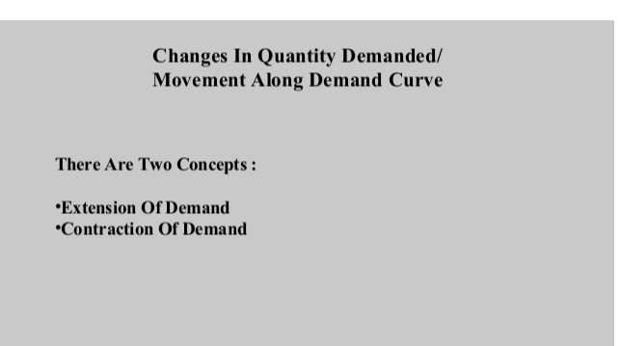

Slide 30
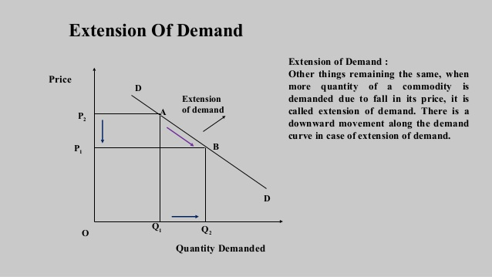

Slide 31
